Slide 1

Q2

Slide 2
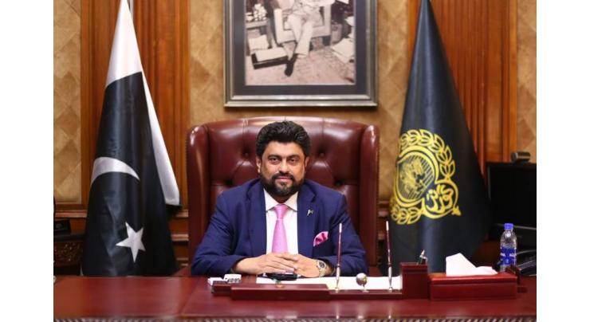
Winter 2025
Thanx to GIAIC
Day of success
January
February
March
S | M | T | W | T | F | S
 |  |  |  |  |  | 1
2 | 3 | 4 | 5 | 6 | 7 | 8
9 | 10 | 11 | 12 | 13 | 14 | 15
16 | 17 | 18 | 19 | 20 | 21 | 22
23 | 24 | 25 | 26 | 27 | 28 | 29
30 | 31
S | M | T | W | T | F | S
 |  |  |  |  |  | 1
2 | 3 | 4 | 5 | 6 | 7 | 8
9 | 10 | 11 | 12 | 13 | 14 | 15
16 | 17 | 18 | 19 | 20 | 21 | 22
23 | 24 | 25 | 26 | 27 | 28
S | M | T | W | T | F | S
 |  | 1 | 2 | 3 | 4 | 5
6 | 7 | 8 | 9 | 10 | 11 | 12
13 | 14 | 15 | 16 | 17 | 18 | 19
20 | 21 | 22 | 23 | 24 | 25 | 26
27 | 28 | 29 | 30 | 31

Slide 3
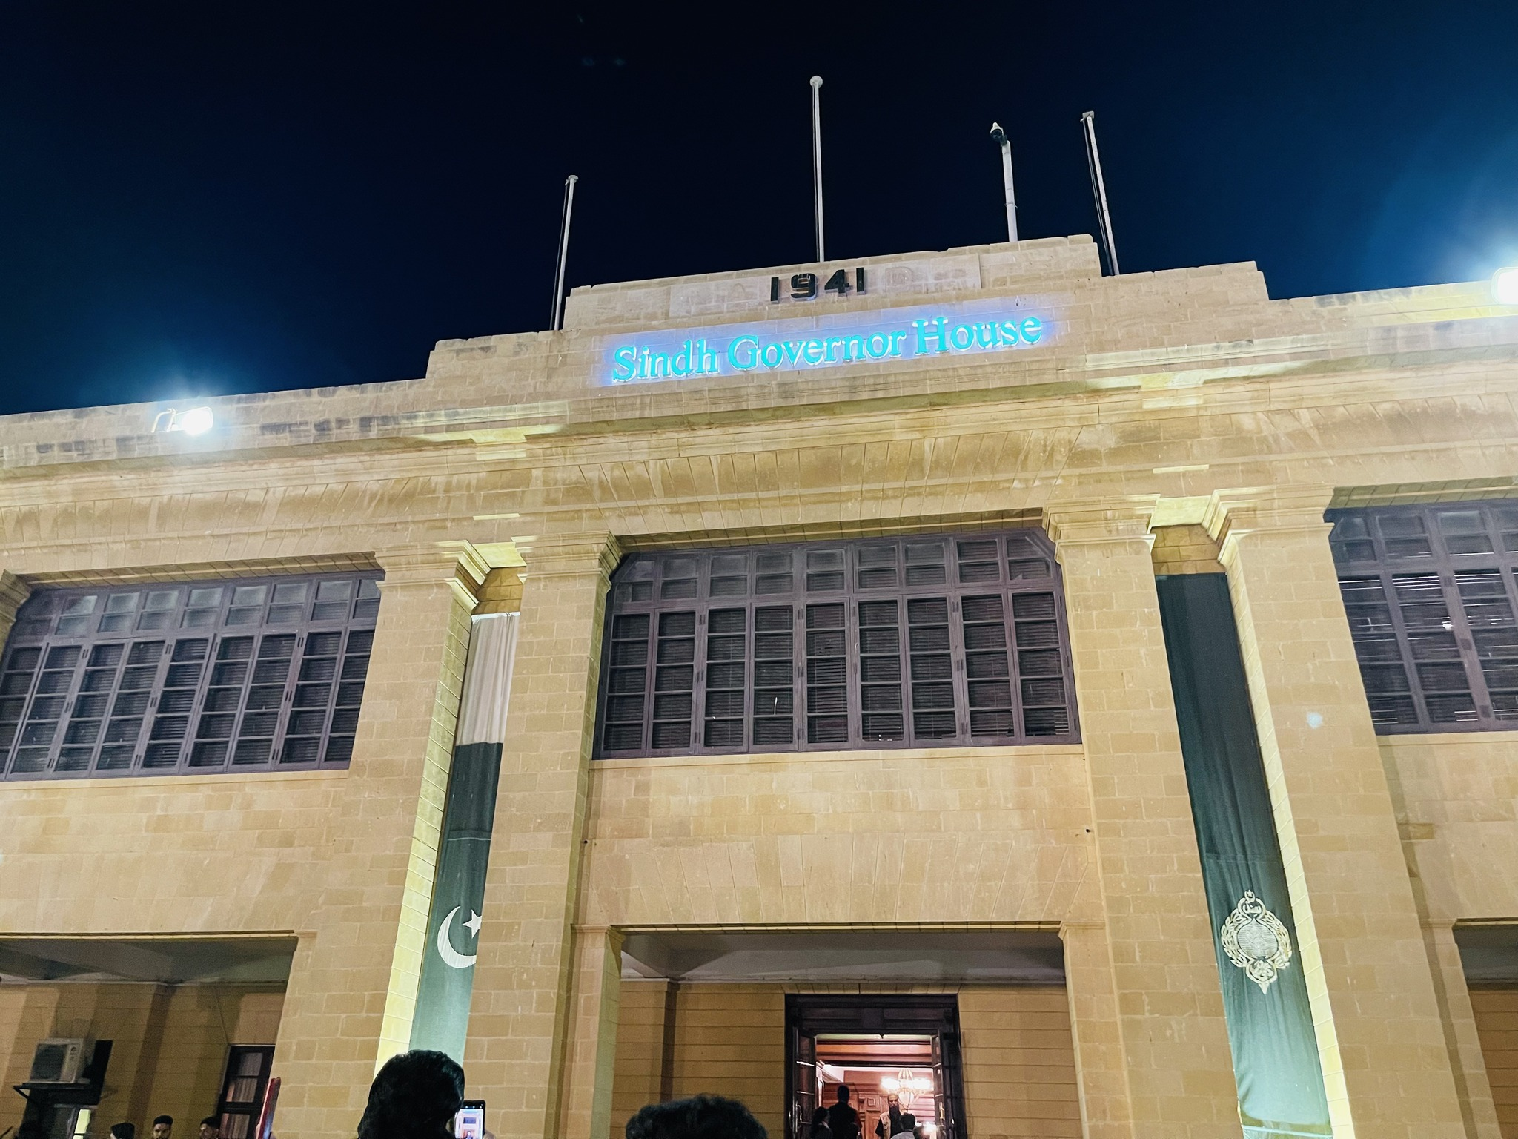
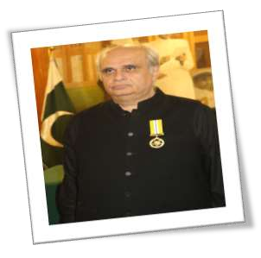
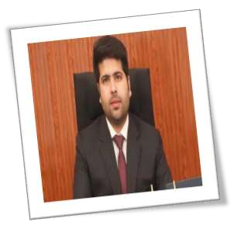
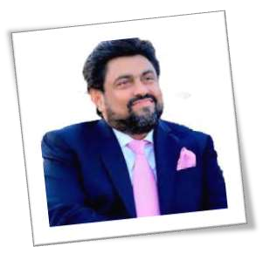
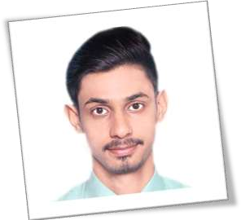
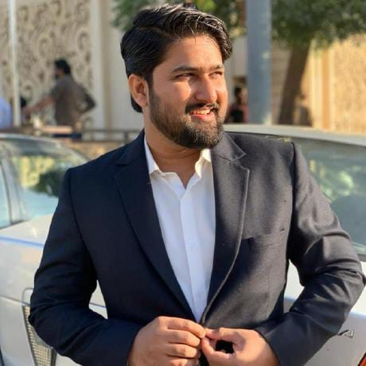
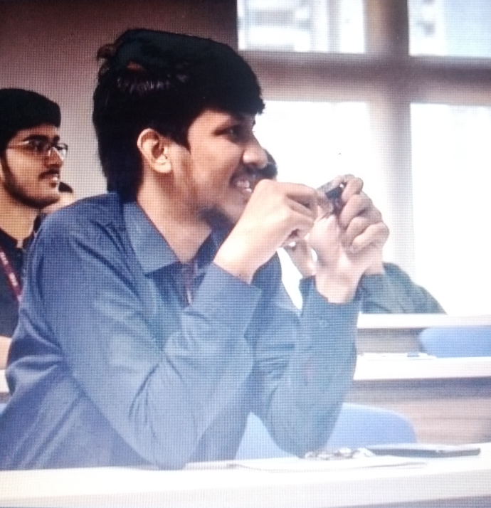
Special Thanx To
CODING HEROES
•
GOVERNOR OF SINDH—KAMRAN KHAN TESSORI
SIR ZIA
SIR DANIYAL NAGORI
SIR AMEEN ALAM
SIR MUHAMMAD BILAL KHAN
SIR ALI AFTAB SHEIKH

Slide 4
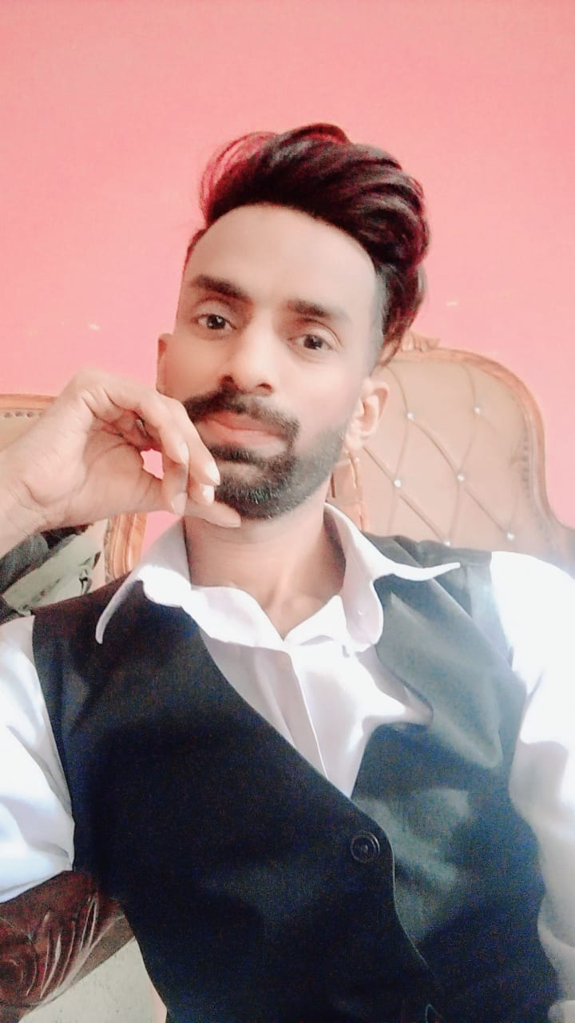
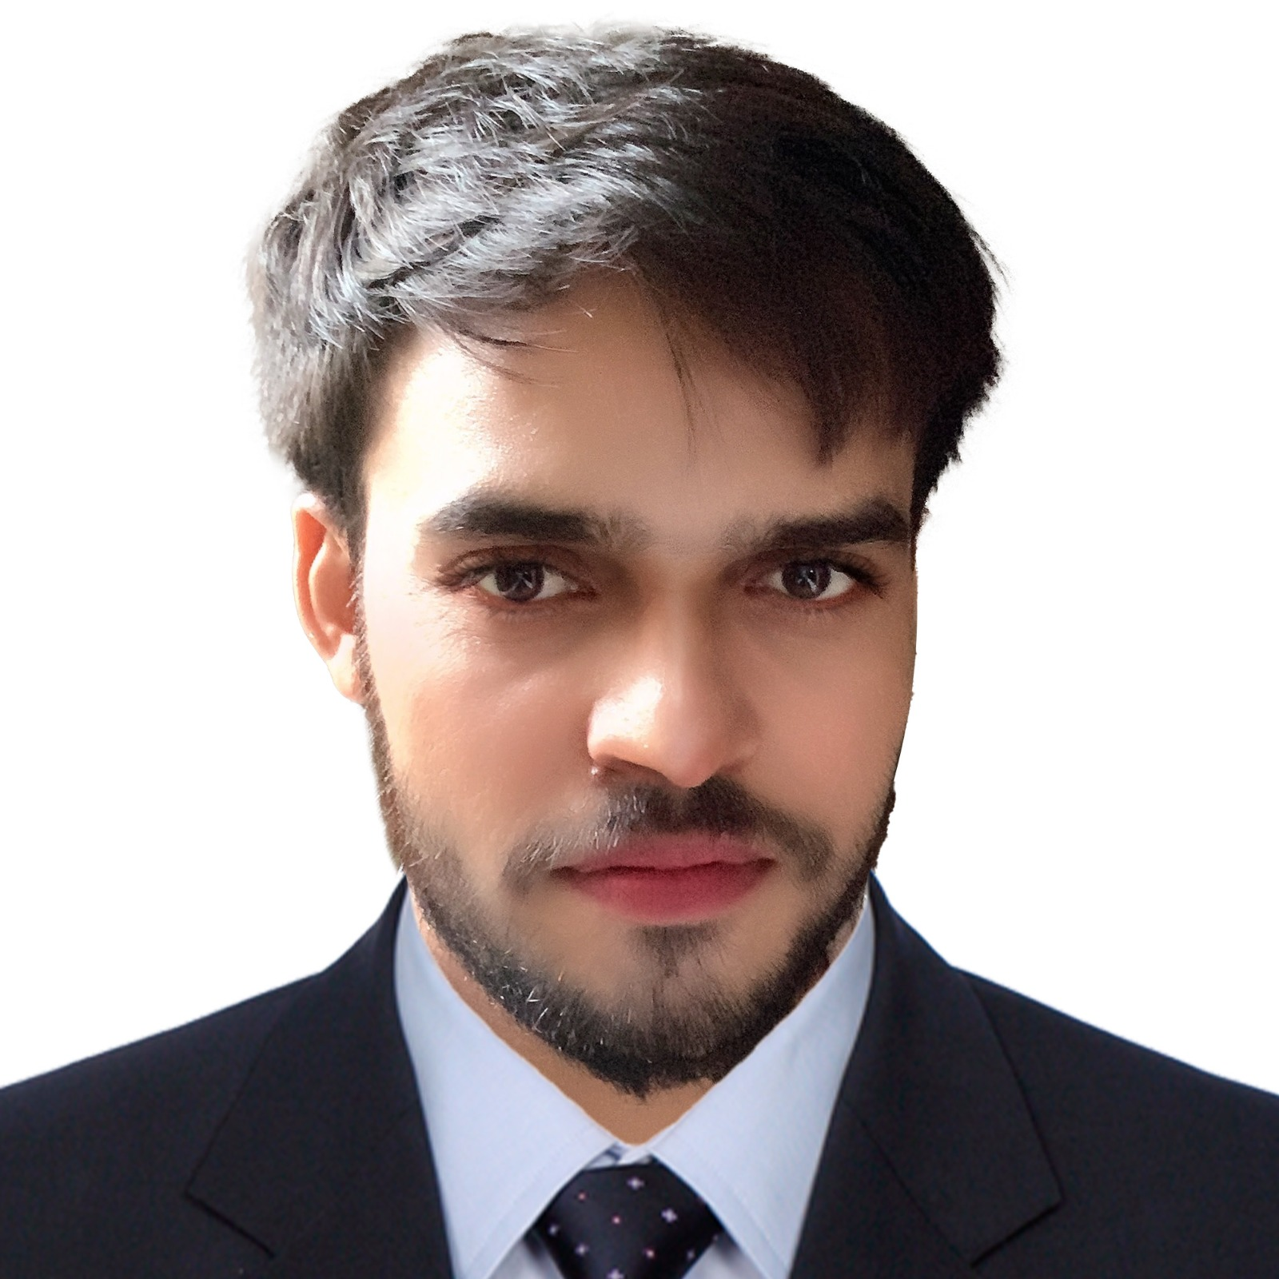
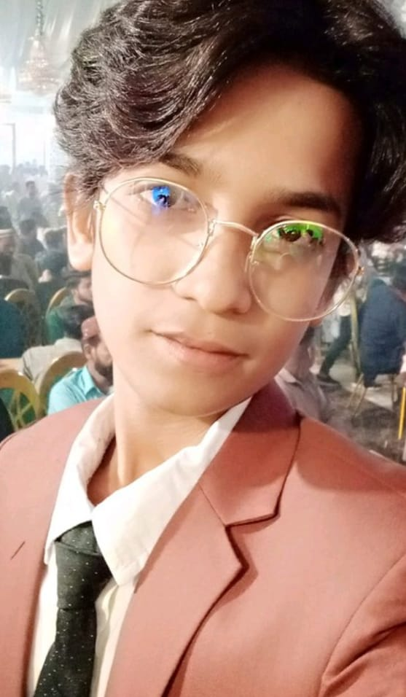
ENGR.SIR ABDUL REHMAN ANSARI #MEMBER OF THE ACADEMY #MASTERS IN MATHEMATICS AND FOOD CHEMISTRY. #B.E IN ELECTRONICS(ENGR.) #EXAMINATION INCHARGE IN SSC-KARACHI.
ZUBAIR #GRAPHICS DESIGNER . #WEB DEVELOPER.
ABDULLAH SHAH #ACCOUNTANT IN THE SCHOLARS SCHOOL. #WEB DEVELOPER.
#DEALING EXPERT.

Slide 5
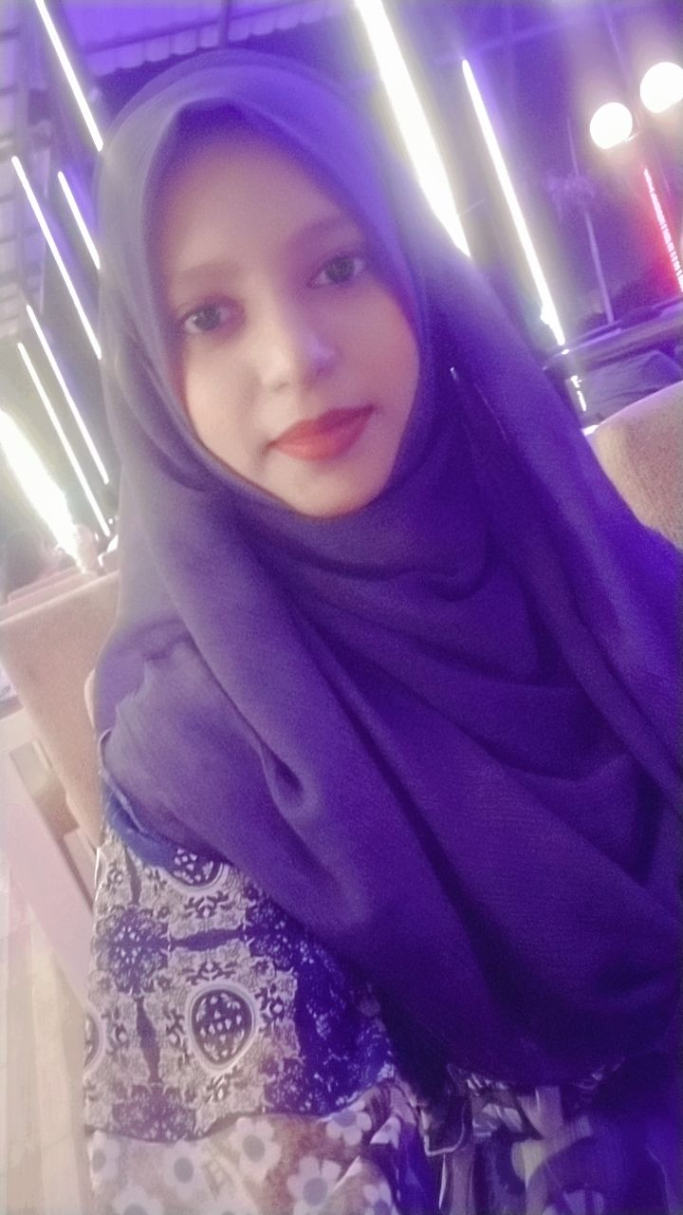
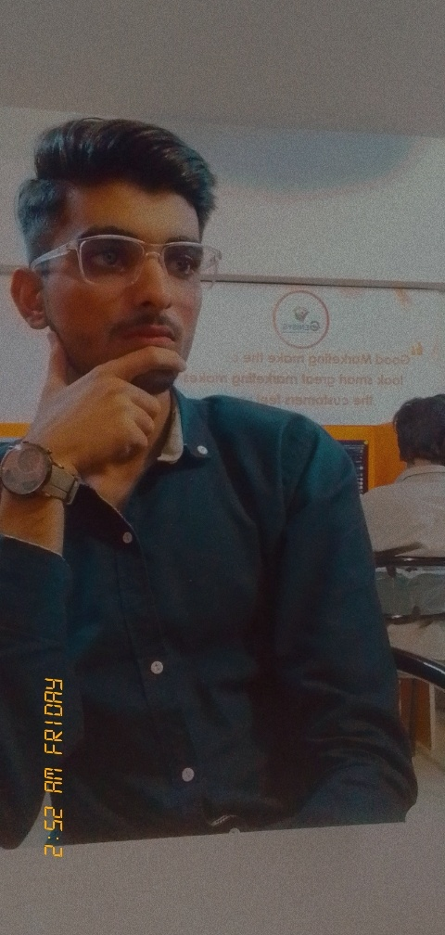
RIDA RASHEED #WEB DEVELOPER #PERFORM HER DUTY AT RECEPTION OF TYC
FARAZ SHAFQAT ALI #EXPERT IN COMPUTER HARDWARE
AND SOFTWARE. #DIGITAL MARKETING.

Slide 6
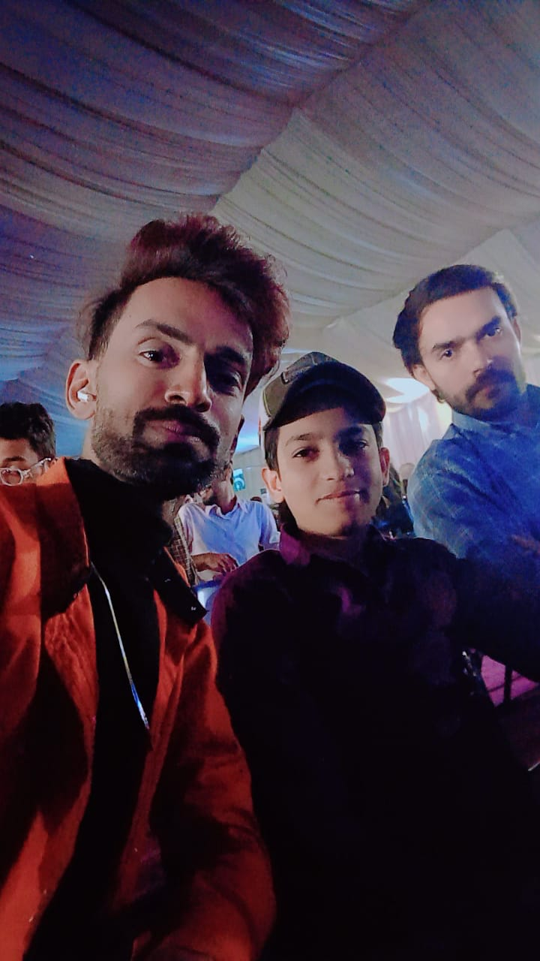
SPECIAL THANX TO ZUBAIR WHO HELPED US A LOT IN DESIGNING OF TEMPLATES

Slide 7

Special Thanx To
ALSO
•
OUR BELOVED SENIORS
ALWAYS RESPECT YOUR SENIORS…

Slide 8
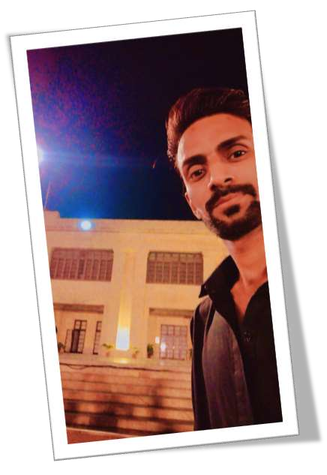








Thank you so much For watching our special thanx
Contact:+923100273708(official)
https://github.com/rehman2017
abdulrehman201717@gmail.com abdulrehman20172024@gmail.com abdulrehman2024@outlook.com
Connected with
Engr Sir Abdul Rehman Ansari(official web developer working at the Academy School near Zia Uddin hospital main campus)

